Slide 1
Orthogonal Separations
Mark R. Schure
Superon
and
Theoretical Separation Science Laboratory,
Kroungold Analytical, Inc.
Blue Bell, Pennsylvania
Joe M. Davis
Dept. of Chemistry and Biochemistry
Southern Illinois University at Carbondale
Carbondale, Illinois

Slide 2

Talk Overview
Orthogonality: Background
    Past work with casual, non-quantitative definitions
Metrics
    Past work
    Comparison on model chromatograms
Quantitative definition
    Local and global definition
Comments, Observations and Conclusions
“There is a great satisfaction in building good tools for other people to use.” Freeman J. Dyson, Institute for Advanced Study, Princeton University

Slide 3
Orthogonality Background: what is this concept?
4 definitions/comments
Refers to “alternative selectivity between separations”¹
“Two separations of quite different selectivity with marked changes in relative retention so that two peaks which are unresolved in one chromatogram will likely be separated in the second chromatogram.”²
Where “systems of elution times are statistically independent.”^{1,3}
“… (total independence from each other) of all n separation mechanisms.”⁴
¹I. Dioumaeva, S.-B. Choi, B. Yong, D. Jones, R. Arora, “Understanding Orthogonality in Reversed-Phase Liquid Chromatography for Easier Column Selection and Method Development, Application Note, Agilent Technologies.
²J. Pellett, P. Lukulay, Y. Mao, W. Bowen, R. Reed, M. Ma, R. C. Munger, J. W. Dolan, L. Wrisley, K. Medwid, N. P. Toltl, C. C. Chan, M. Skibic, K. Biswas, K. A. Wells, L. R. Snyder, J. Chromatogr. A 1101 (2006) 122-135.
³P. Schoenmakers, P. Marriott, J. Beens, Normencl;ature and Conventions in Comprehensive Multidimensional Chromatography, LC-GC Europe, June 2003, 1-4
⁴ L. Blumberg, M. S. Klee, J. Chromatogr. A 1217 (2010) 99-103.

Slide 4
Orthogonality Background : what is this concept?
The term “orthogonality” has many different meanings in different fields:
  Mathematics: two lines are orthogonal if they form right angles at the point of intersection
  Statistics: Independent variables are said to be “orthogonal” if they are uncorrelated.
  Computer science: “orthogonal range trees for database searching”
Questions:
Can one compare multiple 1D chromatograms for orthogonality by forming pairs and evaluating the pairs as a 2D space?
Will the same 1D metric suffice as a metric of quality for a 2D chromatogram?
Can we find a metric for how effectively we are using a 1D, 2D, nD space?
Why is this term orthogonality so prevalent in chromatography now?

Slide 5
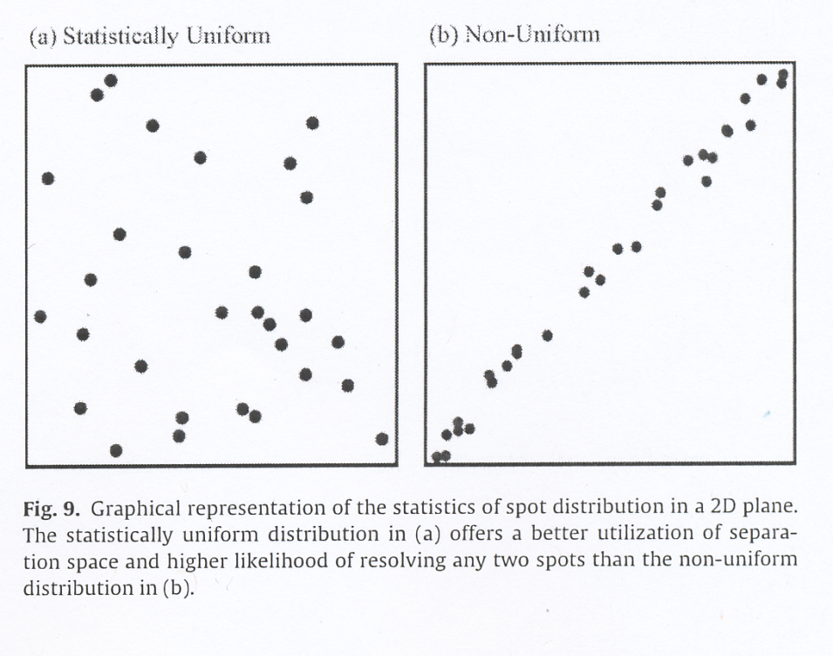
Orthogonality background
Why bother? Want to maximally cover the separation space as efficiently as possible
from: L. Blumberg, M. S. Klee J. Chromatogr. A 1217 (2010) 99-103
This concept applies to 1D as well
In fact it covers separations in nD
Orthogonality measures should be applicable to any number of dimensions
(dimensional invariance)
From: M. R. Schure, J. M. Davis, J. Chromatogr. A, 1218 (2011) 9297-9306
D=0.2 m=100 α=0.23 p/m=0.42

Slide 6
Different ways to measure orthogonality
in the chromatographic literature
Discretization schemes:
  Information theory: entropy, mutual information, %O
  Fractal dimension: D_{BC}
  Fractional coverage: SC_{G} and relative convex hull area
Non-discretized measures
  Correlation coefficients: Kendall, Spearman, Pearson
    Better done as 1-r²
  Spreading angle
  Nearest neighbor distributions
Some of these are better than others !

Slide 7
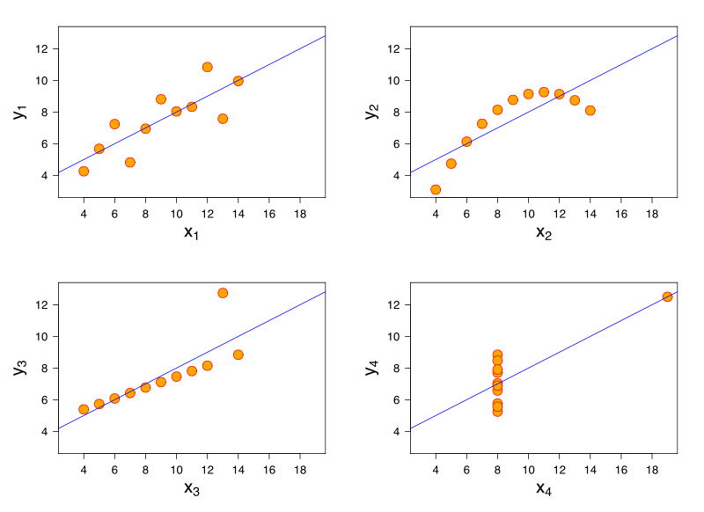
A general statement regarding correlation coefficients
“The correlation coefficient indicates the strength of a linear relationship between two variables with random distribution; this value alone may not be sufficient to evaluate a system where these assumptions are not valid.”
From: Correlation and Mutual Information wiki
Pearson correlation coefficient is horrible, Kendall and Spearman are better.
Here’s the problem with Pearson c.c.’s: very different results give the same c.c. (r=0.816)
This presentation is called Anscombe’s quartet¹
¹Anscombe, F. J. (1973). "Graphs in Statistical Analysis". American Statistician 27 (1): 17–21

Slide 8
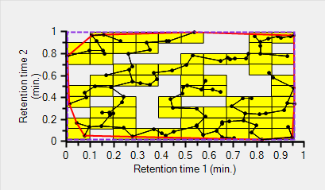
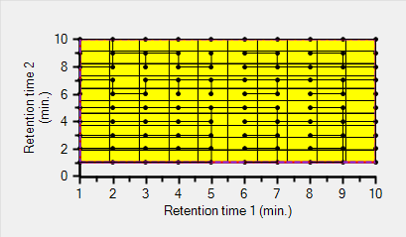
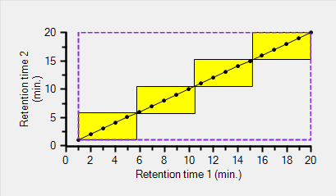
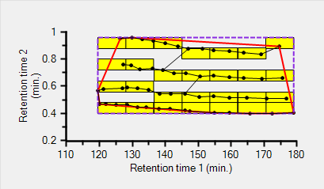
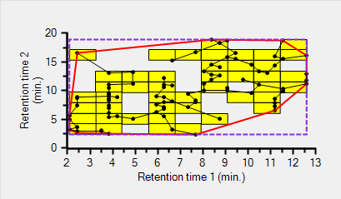
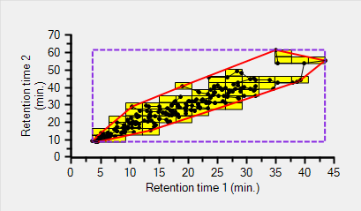
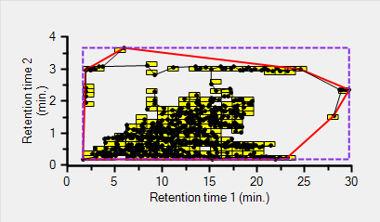
2D Sample Chromatograms and Grades
B
A
F
100 Random points in 2D
100 uniformly spaced points
20 diagonal points
A⁻
B
C
¹Alcohol ethoxylates
²Corn seed extract
³RPLC versus PFP (peptides)
⁴GC x GC (diesel fuel)
¹ R. E. Murphy et al Anal. Chem. 70 4353- (1998)
² P. W. Carr et al unpublished work
³ M. Gilar et al Anal. Chem. 77 6426- (2005)
⁴ W. Winniford et al unpublished work
C
Numerical grade scale: A⁺=98 A=95, A⁻=92 B⁺=88 B=85 B⁻=82…..

Slide 9



Results of Correlation (Kendall) Analysis of 2D Test Data
Methodology:
Orthogonality numbers produced in OrCa¹
Numbers crunched with R studio² scripts for statistical analysis
¹ OrCa:
Kroungold Analytical, Inc. www.kroungold.com
² The project and
for statistical computing:
www.r-proj.org and www.rstudio.com
The correlation coefficients are calculated as 1-r_{x}²

Slide 10
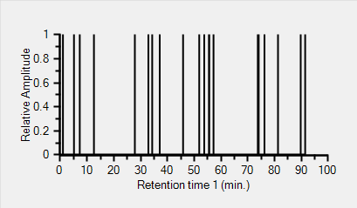
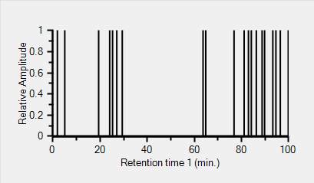
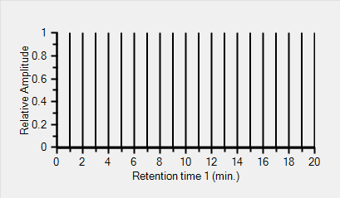
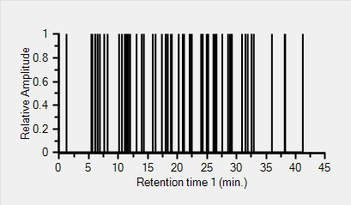
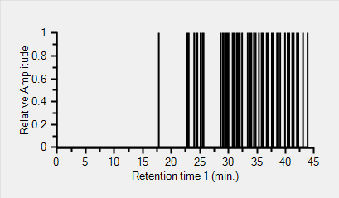
1D Sample Chromatograms and Grades
B
C
A
20 random points
20 fractal points, D=0.5
20 uniformly spaced points
Grades were assigned on the experimental data which had finite broadening
B+
B
57 peaks from peptide sep.¹
45 peaks from glycan sep.²
¹ data from M. Gilar, see M. R. Schure, J. Chromatogr. A 1218 293- (2011)
² unpublished data from B. Boyes

Slide 11
Results of Correlation (Kendall) Analysis of 1D Test Data
Note for 1D lack of:
correlation coefficients
hull statistics
%O

Slide 12
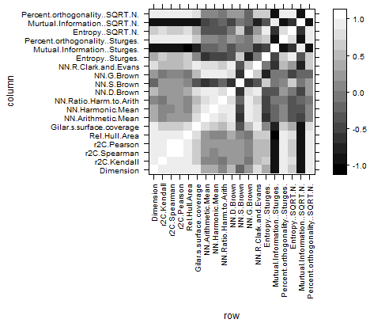
2D Test Chromatogram cross -correlation of orthogonality measures
Dimensionality, 1-r_{x}²,rel. hull area, Gilar’s surface coverage, NN_{C&E} and % orthogonality all appear to be correlated

Slide 13
1D Test Chromatogram cross-correlation of orthogonality measures
Doesn’t show the same cross-correlations as the 2D cross-correlations but this might be due to the finite extent of the dataset.
Obviously 1D analysis has less metrics than the 2D metrics

Slide 14
Results of Correlation (Kendall) Analysis of 2D Gilar’s Peptide Data

Slide 15
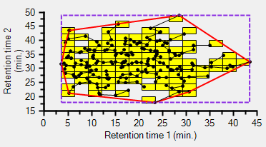
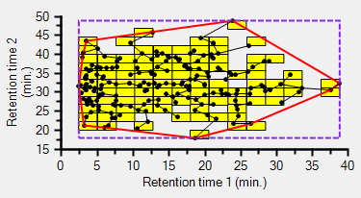
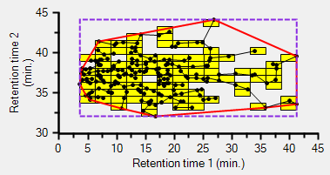
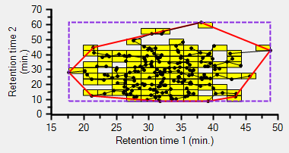
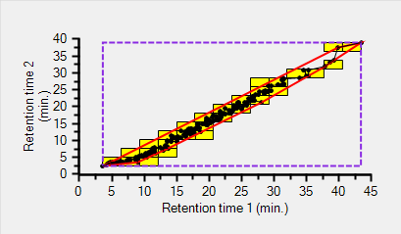
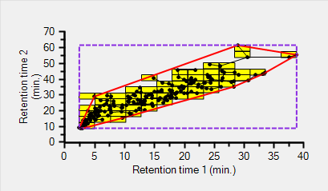
The good the bad and the ugly peptide chromatograms
The good: highest D and other metrics
Columns:
1: C₁₈ pH 2 2: Phenyl
3: C₁₈ pH 10 4: HILIC pH 4.5
5: SEC (60 A) 6: SCX
7: PFP pH 3.25
File | Dimension | 1-r^2 Ken | 1-r^2 Spear | 1-r^2 Pearson | Rel. Hull Area | Rel. SC (G) | N.N. Arithmetic mean | N.N. R_CE | % orthogonality [Sturges] | % orthogonality [Sqrt(N)]
D14.csv | 1.648 | 0.999588 | 0.999205 | 0.999324 | 0.6938 | 0.5102 | 0.0321 | 0.8981 | 96.2516 | 83.1189
D24.csv | 1.6319 | 0.998803 | 0.997667 | 0.997148 | 0.6946 | 0.5 | 0.0317 | 0.8877 | 95.8501 | 84.5437
D35.csv | 1.5895 | 0.999507 | 0.998601 | 0.998718 | 0.758 | 0.4694 | 0.0308 | 0.861 | 97.3087 | 86.1754
D47.csv | 1.5929 | 0.999628 | 0.99921 | 0.99881 | 0.6949 | 0.4898 | 0.0313 | 0.8764 | 97.7706 | 85.4503
The bad: lowest D and other metrics
File | Dimension | 1-r^2 Ken | 1-r^2 Spear | 1-r^2 Pearson | Rel. Hull Area | Rel. SC (G) | N.N. Arithmetic mean | N.N. R_CE | % orthogonality [Sturges] | % orthogonality [Sqrt(N)]
D17.csv | 1.3014 | 0.35984 | 0.10584 | 0.12615 | 0.3109 | 0.2602 | 0.0183 | 0.5135 | 42.984 | 51.8157
D27.csv | 1.3492 | 0.38769 | 0.12578 | 0.15948 | 0.3551 | 0.2755 | 0.0197 | 0.5506 | 51.4798 | 52.0772

Slide 16
Convex hulls from experimental data of corn seed extract and peptides on 7 different columns
A
B
A: peptide data by 1st dimension column according to color
B: studies of corn-seed extract
C: by rel. hull area blue: 0.5-0.6
red: 0.6-0.7
D: by rel. hull area
green: 0.7-0.8
blue: 0.8-0.9
Black: 0.9-1.0
C
D

Slide 17
Hull statistics for 2D random retention data
Coverage:
70-80 peaks are needed to reach 90% coverage of the 2D area
Variability:
Surface coverage for small number of peaks varies much larger than for separations with large number of peaks.

Slide 18
Mark and Joe’s Orthogonality Definition
Maximum orthogonality implies:
1. Maximization of peak spacing uniformity (local)
and for n ≥ 2
2. Maximization of the relative convex hull area (global)
Considers local and global properties of peaks
Views the definition of orthogonality as an optimization problem
Does not assign particular metrics although the choice is somewhat obvious
Works for both random, ordered and partially disordered chromatograms

Slide 19
For maximum orthogonality
For 1D chromatography with 1 column:
During method development get the maximum D
For 1D chromatography with >1 column:
Form pairs and get the maximum D and maximum convex hull area
For 2D chromatography:
Get the maximum D and maximum convex hull area
These guidelines tend to deemphasize time constraints

Slide 20
Comments on orthogonality
Having one number representing a chromatogram (many numbers) and “distilled/averaged/condensed” to give the properties of many numbers is wishful thinking but serves OK for optimization in method development.
Dimensionality D is “scale free”. However much like packing structures, there are different measurements for different length scales.
Fastest chromatograms: Maximize nearest neighbor distances and minimize the total separation space while maximizing the convex hull area for 2D and greater nD.
Surface coverage is one point in the box counting dimensionality algorithm. It is the easiest measure to interpret. Discretization level must be specified, as in Gilar’s latest definition of surface coverage. D encompasses surface coverage¹.
Correlation coefficients don't work well as a measure of orthogonality of chromatographic data. One or few outliers can change r significantly. Correlation can only measure linear dependence; how many 2D chromatograms are linear?
¹M. Gilar, J., Fredrich, M. R. Schure, A. Jaworski, Anal. Chem. 84, 8722 (2012).

Slide 21
Acknowledgements
Francois Huby, The Dow Chemical Company:
GC/MS of oranges, lemons, lime, Lagavulin and Talisker Scotches
Martin Gilar, Waters Corp.: Peptide chromatograms
Pete Carr and coworkers, Dept of Chemistry, Univ. of Minnesota:
2DLC of corn seed extracts and other 2D chromatograms
Bill Winniford, The Dow Chemical Company: 2DGC of Diesel Fuel
Tom Waeghe, MAC-MOD Analytical, Inc.

Slide 22

Thanks for listening ! Mark

